Slide 1
Face Recognition Based Attendance System
The best tool for acknowledging presence

Slide 2
TOC
Overview
Understanding the problems
Project objective
Demo

Slide 3
Overview
A face recognition-based attendance system utilizes facial recognition technology to accurately identify individuals. During enrollment, facial images are captured and unique templates are created for each person. These templates are stored in local storage along with corresponding identities. When individuals need to mark their attendance, they stand in front of a camera for real-time facial recognition(for now images are manually uploaded). Advanced algorithms analyze facial features to determine a match with stored templates. Upon recognition, attendance is recorded along with a timestamp. High accuracy and security measures ensure reliability and privacy. Administrators can access attendance records. Overall, this system offers a convenient, efficient, and secure solution for attendance tracking.

Slide 4
Understanding the problems
01
Inaccuracies in manual attendance tracking.
02
Time-consuming processes associated with traditional methods.
03
Security concerns, including the risk of proxy attendance.

Slide 5
Project objective
The project objective is to create a face recognition-based attendance system to automate tracking processes and enhance accuracy. It aims to minimize errors associated with manual methods and increase efficiency in attendance recording. By implementing biometric authentication, it seeks to improve security and prevent fraudulent practices like proxy attendance. Integration with existing systems will ensure seamless data management and reporting. Overall, the goal is to provide a reliable and user-friendly solution for attendance management.

Slide 6

Home Page

Slide 7
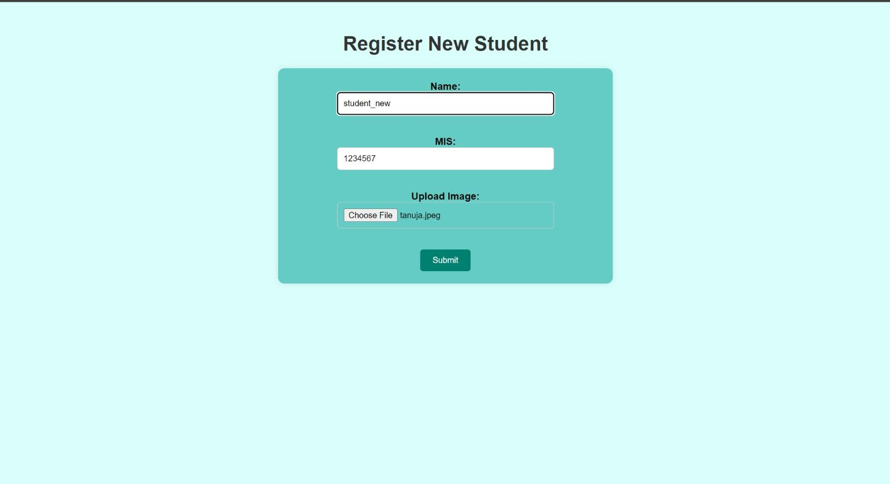
Registration Page Here is where new Students can be added To a class.

Slide 8
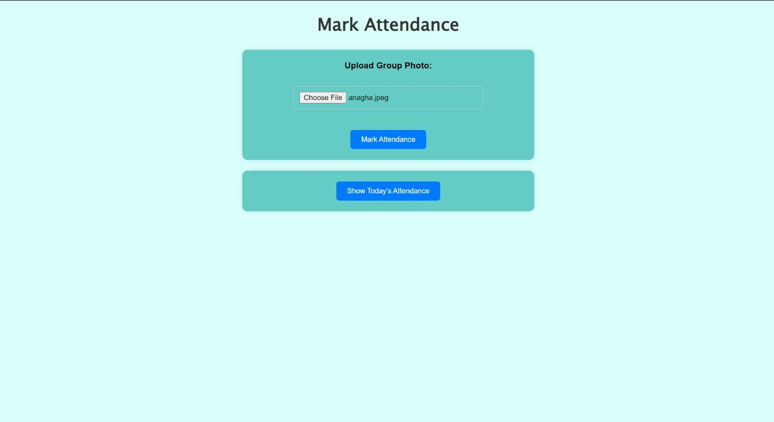
Attendance Page
Here is where photos of Students will be uploaded For marking their attendance

Slide 9
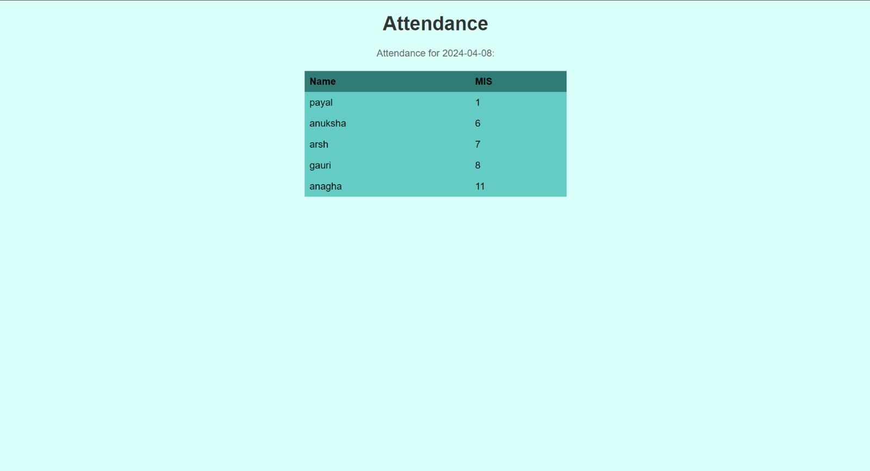
Here is where The lecture of a Particular session Can be seen

Slide 10
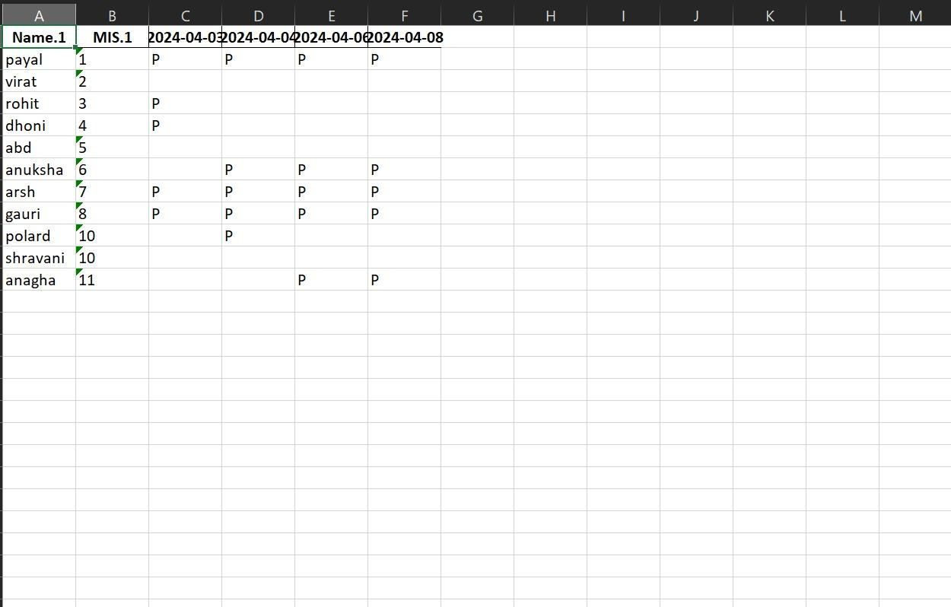
This is the excel sheet Where the attendance gets recorded

Slide 11

Thank you!

